Slide 1

Geospatial Location of Active Mines in the United States of America in order to Detect Hidden Relationships of Mineral Distributions Using Programming and Analytical Tools by Ekene, Edmundo, Muhammed February 25, 2021

Slide 2
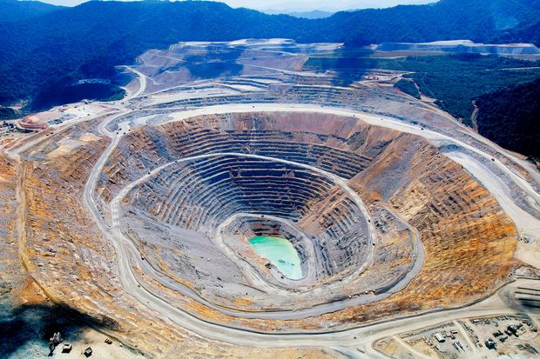
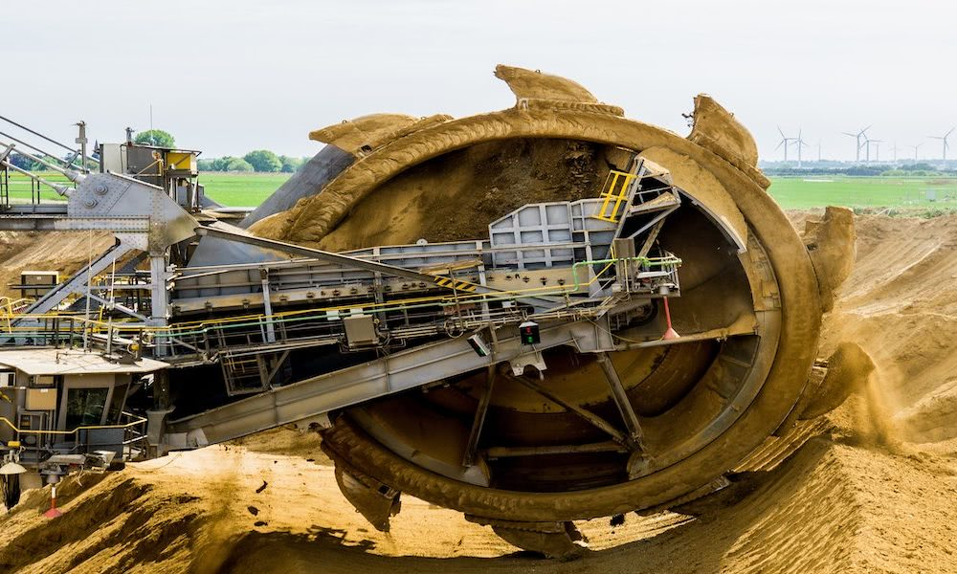
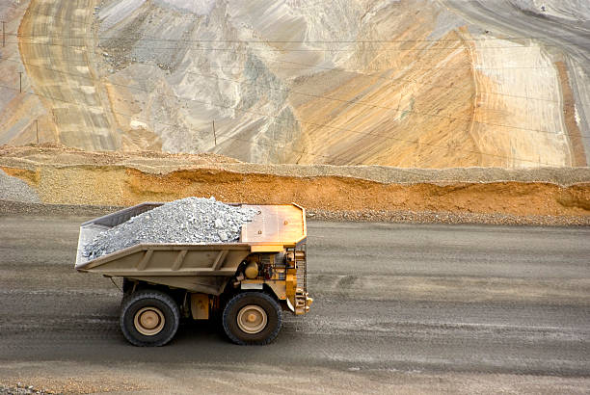
Objective
To use a database of identified active mines covering different commodities such as aluminum, copper, gold and iron to understand the distribution of these solid minerals across United States and to reveal possible spatial relationship between these commodities and other sort of solid minerals.

Slide 3

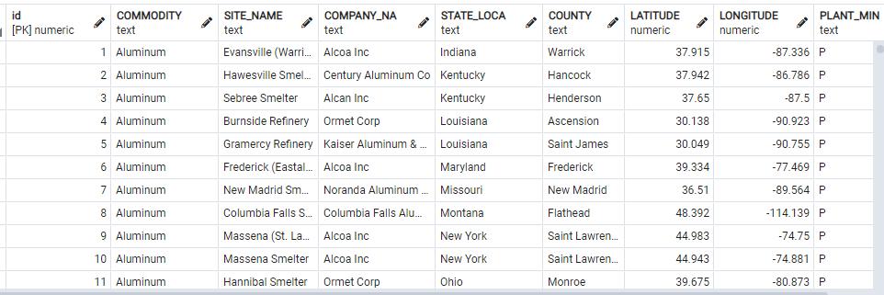
Data source
https://data.world
Title of data: Active mines & processing plants in the United States of America in 2003
Data Structure: (6785 rows, 9 columns)

Slide 4


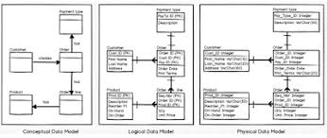
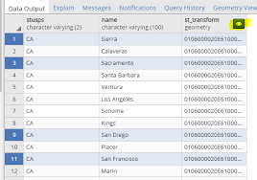
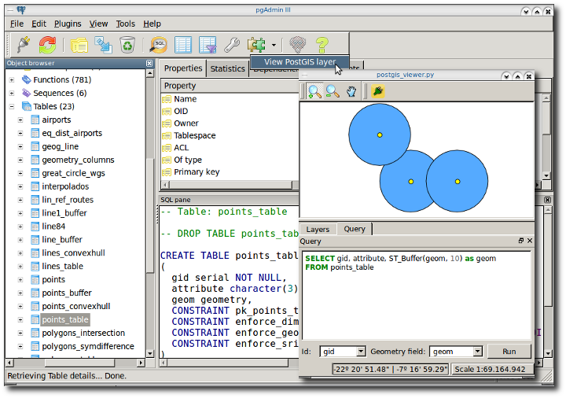

Methodology / General Workflow
US MINES DATA
(csv, shapefile)
EXPLORATORY DATA ANALYSIS
(PYTHON, ARCMAP)
DATA MODELLING
(CRUD, ETL)
RESULTS AND INTERPRETATION
QUERIES/DATA MANIPULATION (PYTHON, PGADMIN, GEOSOM)
CONNECTION BETWEEN DATABASE
PGADMIN / POSTGRES / POSTGIS

Slide 5
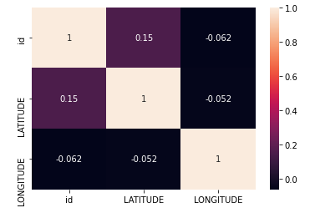
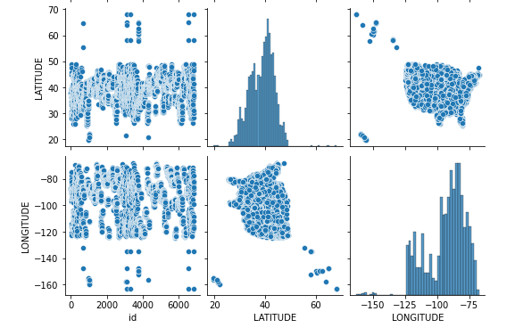
Exploratory data analysis using Python
Relationship analysis between variables by looking at their correlation matrix
Visualizing the relationship between only two variables by using pairplot

Slide 6
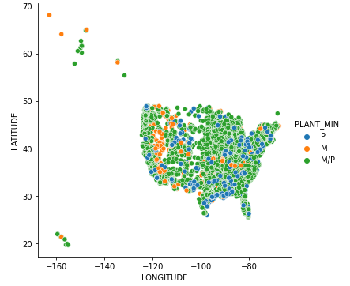
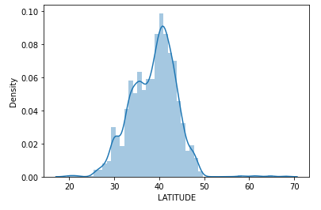
Exploratory data analysis using Python
To further visualize the relationship between variables we use scatter plot
We also looked at histogram to understand the shape, spread and continuous sample of data.

Slide 7
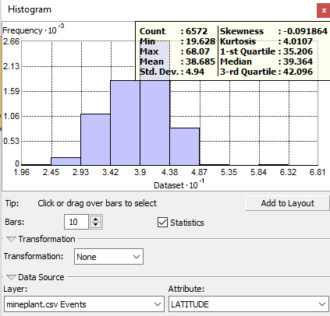
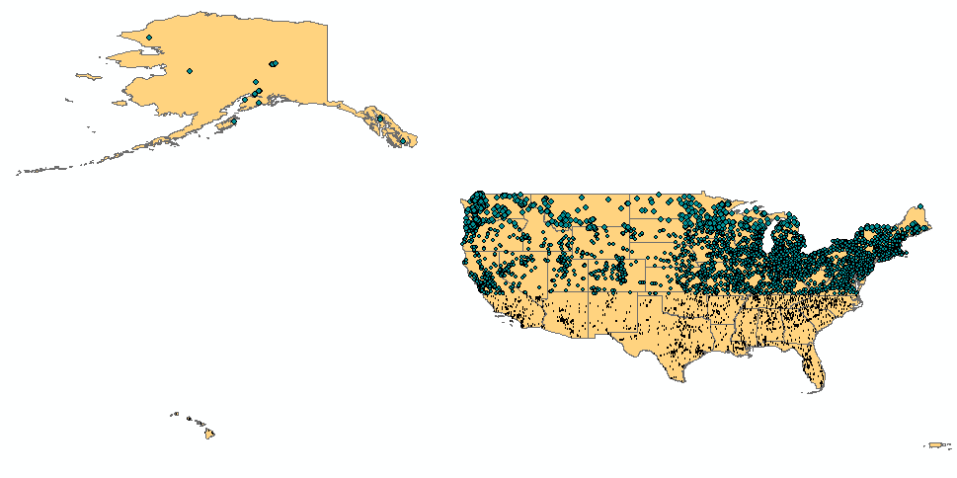
Spatial analysis using ArcMap
Histogram shows that the distribution of variables is negatively skewed to the left.
There are more mining sites in the North East than in the South or Mid West as shown below.

Slide 8
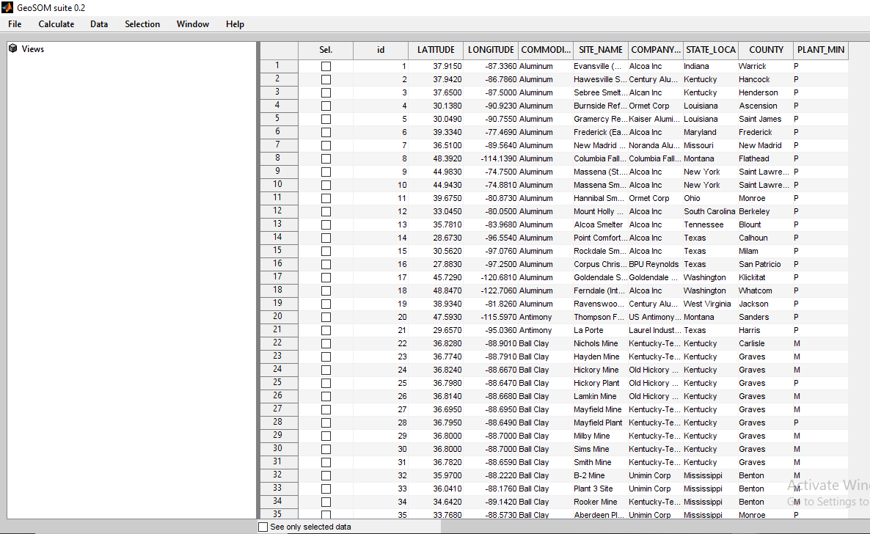
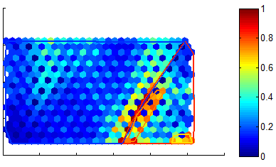
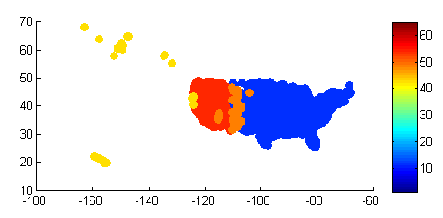
Data manipulation using GeoSOM
GeoSOM. Below is the U-Matrix of commodity distribution in the United States delimited with 4 clusters
GeoSOM suite main window defining clusters from a standard SOM trained with 2003 active mines in the United States.
GeoSOM map of active mines in the United States as of 2003 showing areas with higher distribution of commodities in the Eastern part of USA.

Slide 9
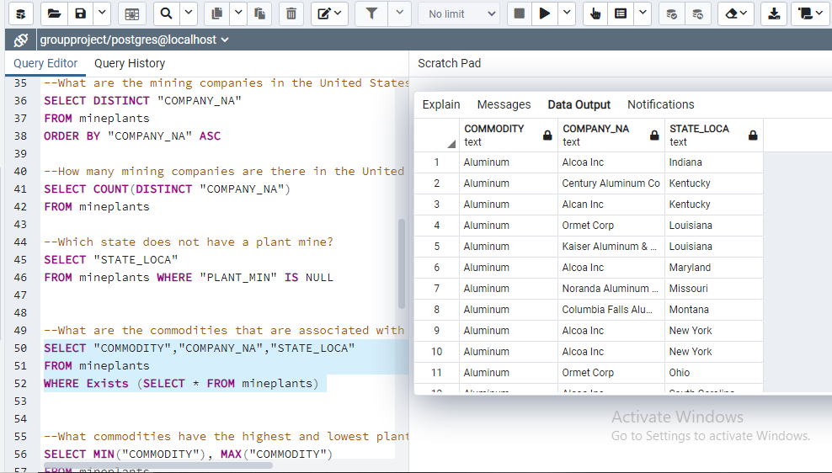
Data grouping and query using pgAdmin
--What kinds of commodities were identified in this mines?
--How many commodities are being mined?
--What are the states that are mining aluminum, copper, gold, and iron?
--What are the mining companies in the United States?
--How many mining companies do we have in the United States?
--Which state does not have a mining plant?
--What are the commodities that are associated with each company and each state?
--What commodities have the highest and lowest mining plants?
--Which company has the highest and lowest number of mining plants?
--Which state has the highest and lowest number of mining plants?
--Which commodities are majorly mined by a state?
--How many states are involved in mining?
--How many mining sites are there in the United States?

Slide 10
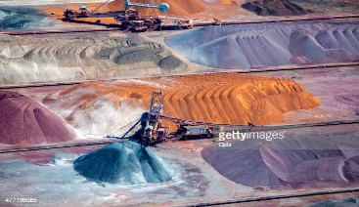

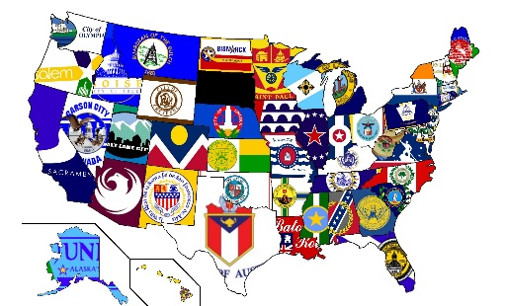
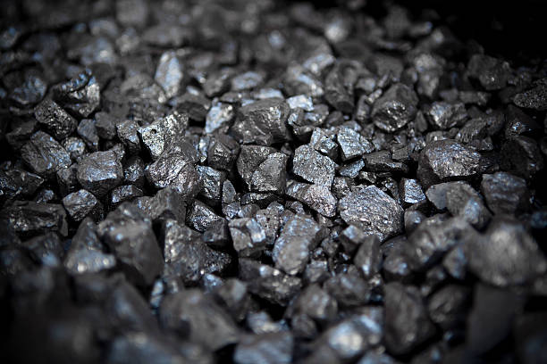
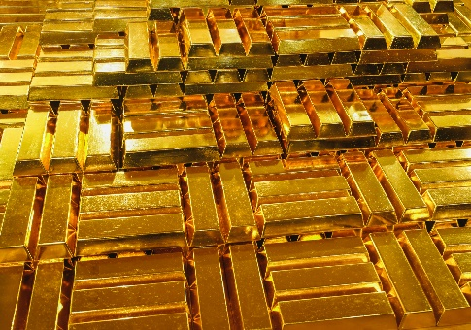
Results and Interpretation
6039 mining sites in USA
3796 mining companies in USA
At least, each state has a mining site
69 solid minerals are being mined in USA
Aluminum is being mined by 13 states
Copper is being mined by 8 states
Gold is being mined by 12 states
Iron is being mined by 2 states

Slide 11
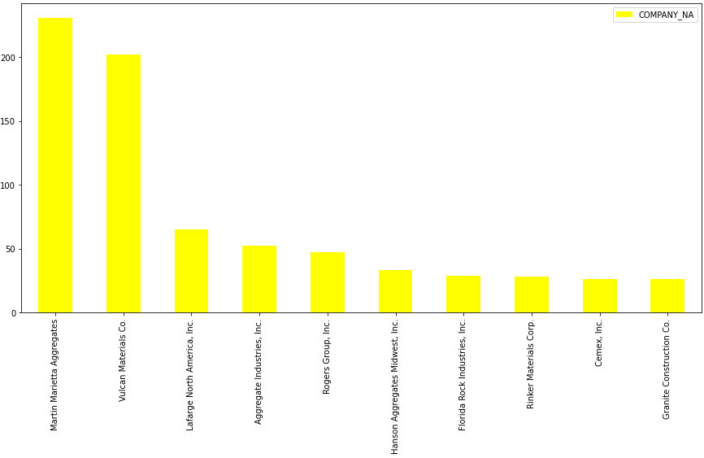
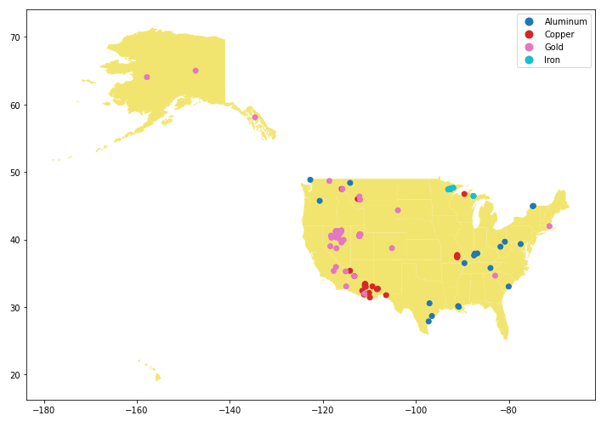
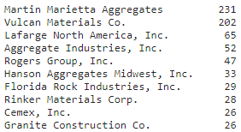
Interpretation of Results (Python)
Top ten mining companies in USA
Distribution of commodities

Slide 12
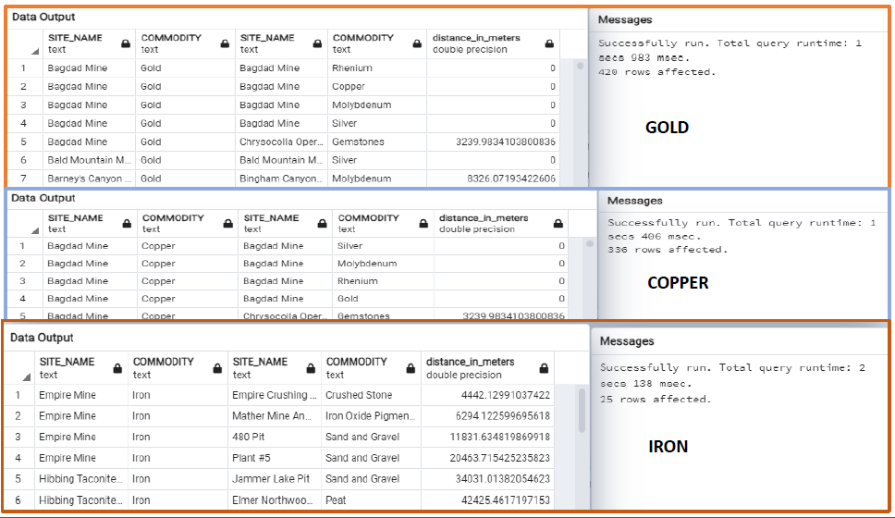
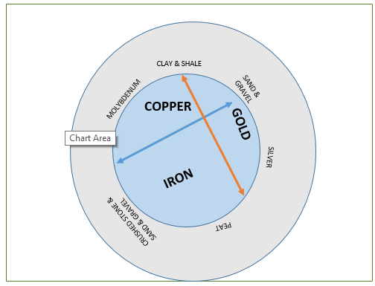
Commodities associated with Gold, Copper and Iron deposit within 50km radius

Slide 13
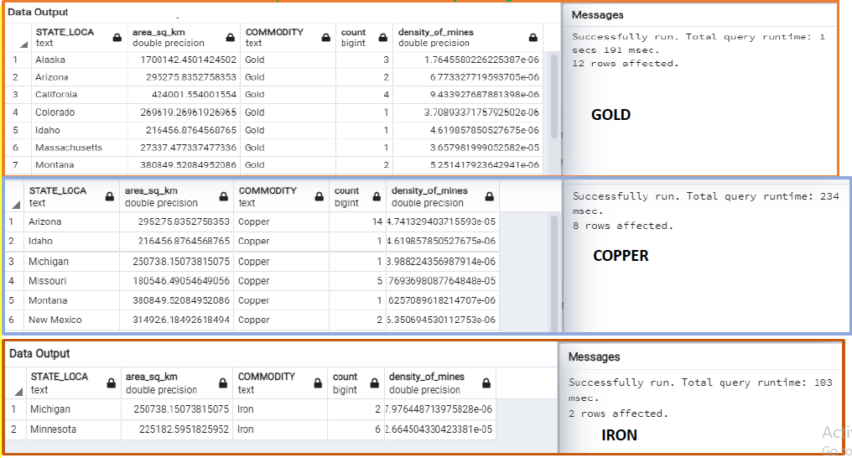
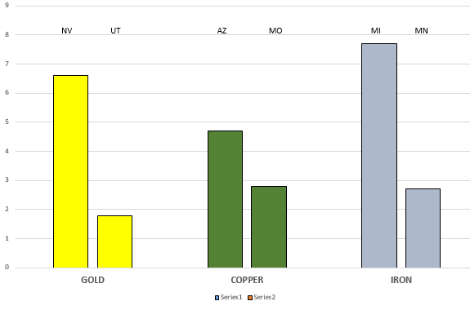
Density of mineralization of Gold, Copper and Iron per State (deposit/100,000km²)

Slide 14

Thank you!
Discussion
Address: Campus de Campolide, 1070-312 Lisboa, Portugal
Tel: +351 213 828 610 | Fax: +351 213 828 611

